Slide 1
RETAIL REPORT 2027
TEAM 6
SEPTEMBER
WWW.FOX_REPO.COM

Slide 2
Agenda
01
06
Introduction
Sales By Category
02
07
Executive Summary
Customer Segments
03
08
Problem Statement
Geography
04
09
Sales by Region
Forecast
05
10
Top Product Performance
Conclusion & Next Steps

Slide 3
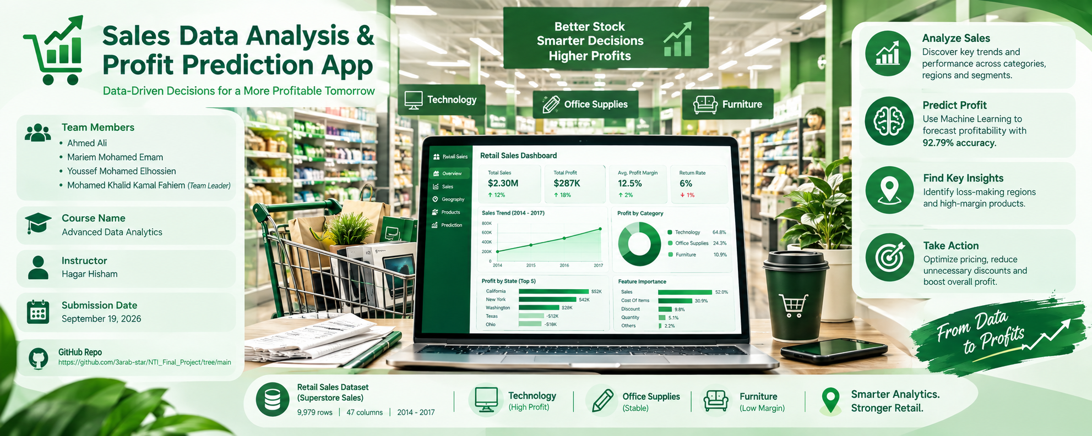
Hello everyone, and a special welcome to our instructor, Eng. Hagar. Have you ever wondered how retail businesses generate millions in sales, yet still end up losing money? We asked ourselves this exact question. My name is Mohamed Khalid, and with my talented team of Ahmed, Mariem, and Youssef, we are excited to present our final project: the Sales Data Analysis and Profit Prediction App. In this project, we didn't just look at past sales; we built a complete pipeline to forecast profitability.
Introduction

Slide 4
Executive Summary
01
The Business Question: How can we accurately predict transaction profitability and identify the key drivers of profit and loss across different retail categories and regions?
Key Finding & Recommended Action: The analysis revealed that while Furniture generates high revenue, it yields extremely low profit margins due to high discount rates, whereas Technology (especially Copiers and Phones) drives the majority of net profit. A Random Forest model successfully predicted profit with 92.79% accuracy based on sales and cost data. Action: We recommend revising the discount strategies in underperforming states (like Texas and Ohio) and reallocating marketing efforts toward high-margin Technology products.

Slide 5

Quarterly Sales Performance
Revenue By Quarter
Q1
74.45 K
Steady start, supported by enterprise deals.
Moderate revenue growth supported by early seasonal campaigns.
Q2
85.73 K
Q3
145.42 K
Significant sales surge accompanied by a sharp rise in promotional discounts.
Q4
179.63 K
Peak revenue period driven by aggressive year-end holiday promotions and high discount volume.

Slide 6




Sales by Region
Regional Sales Distribution
WEST
South
Continues to lead in revenue and customer base.
Stable growth with strong SMB engagement.
Central
East
Fastest-growing region with new partnerships.
Merging markets with great expansion potential.

Slide 7
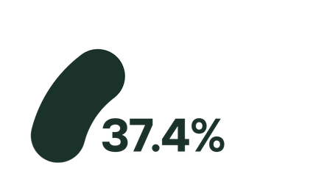

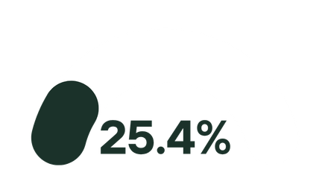
Top Product Performance
Product Revenue Distribution
Phones
Chairs
Storage
Best-selling item, especially in enterprise sector.
Strong performer after recent updates.
Rapid growth in mid-market segment.

Slide 8

Sales By Category
Categories Sales Comparison
Technology
36%
Impressive results achieved by Technology Category
Furniture
32%
Enhanced Sales growth.
Office Supplies
31%
Good Growth

Slide 9
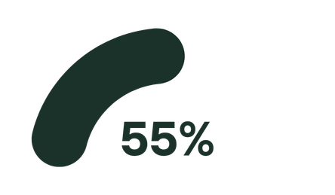
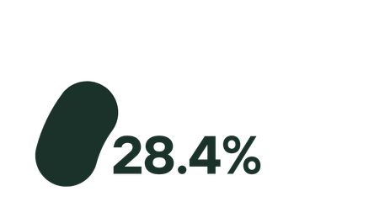
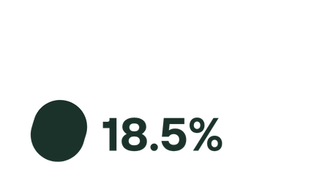
Customer Segments
Consumer
Corporate
Home Office
Main revenue contributor with long-term contracts.
Fast-growing group, boosted by digital campaigns.
New market opportunity

Slide 10
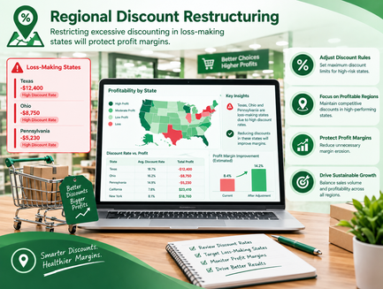
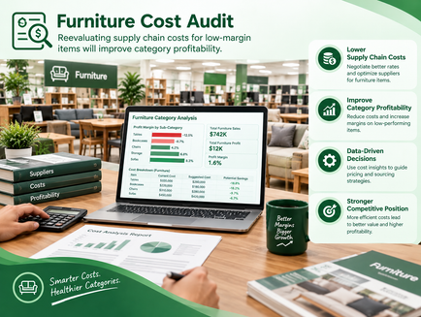
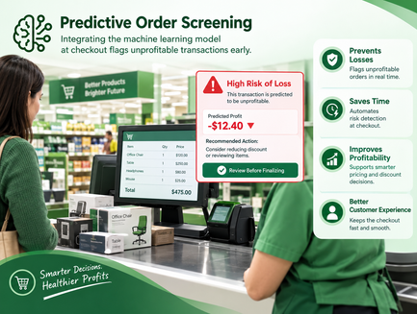
Recomendations
01
02
03
Regional Discount Restructuring
Furniture Cost Audit
Predictive Order Screening
Restricting excessive discounting in loss-making states will protect profit margins.
Reevaluating supply chain costs for low-margin items will improve category profitability.
Integrating the machine learning model at checkout flags unprofitable transactions early.

Slide 11

Forecast
01
Data Preprocessing & Pipeline Setup
02
Model Training & Evaluation
03
Profit Prediction & App Integration

Slide 12

Tech Stack
01
Python : Cleaning, Exploring, Modeling
Pandas, Matplotlib, Seaborn, Plotly, Stream
02
Power Bi : Visualization Tool
03
Deployment

Slide 13
THANK YOU
TEAM 6
SEPTEMBER
WWW.FOX_REPO.COM

